Slide 1

Invest
Stock Market price prediction

Slide 2

SUBJECT : INTRO TO MACHINE LEARNING
TEAM NAME : TKM CODERS
TEAM MEMBERS : VEMULA TANUSH
SOHITH SAI
SAI CHARAN
GUIDE : DR . SHRAWAN KUMAR SIR

Slide 3
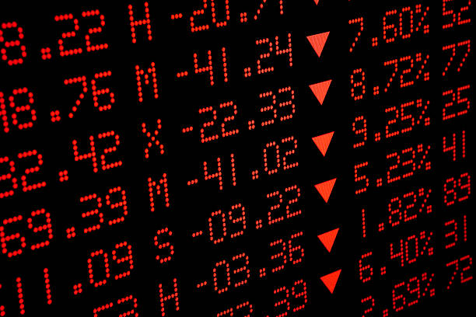
The Problem
Understanding Stock Market Challenges
Market Volatility
Data Complexity
Rapid fluctuations in the stock market are driven by a myriad of factors, including economic indicators, political events, and psychological influences, creating uncertainty for investors and analysts alike.
The stock market generates large, non-linear time-series data sets that are challenging to analyze. These complexities require sophisticated algorithms to extract meaningful insights and facilitate accurate predictions.

Slide 4


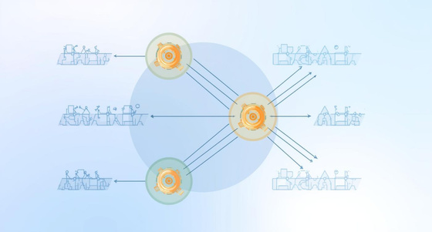
Historical Prices
Dataset
and Machine Learning Methods
Includes open, close, high, low, and volume data
Key Features
Daily trends and sentiment indicators enhance predictions
Algorithms Applied
Diverse methods improve accuracy and prediction capabilities

Slide 5
Prediction Model
Understanding Input and Processing Steps
Input Data
Data Processing
The model utilizes historical prices and technical indicators, including open, close, high, low, and volume data, to generate comprehensive insights for stock market predictions.
Data undergoes essential steps, including cleaning, normalization, and transformation into time-series sequences, ensuring the information is ready for accurate analysis and future price predictions.

Slide 6



Impact and Future Opportunities in Stock Prediction
Informed Trading
Data-driven insights empower investors to make decisions.
Trading Platforms
Enhanced tools improve user experience and accessibility.
Real-Time Data
Instant updates keep traders informed and agile.

Slide 7

Thank You!
We appreciate your interest and welcome your questions about our presentation.
Phone: 9959097583
Email: rayala.charan_cs25@gla.ac.in

